Slide 1
Empowering
Others
with
Becky McCrary, CSP
and
Joe McNemar

Slide 3
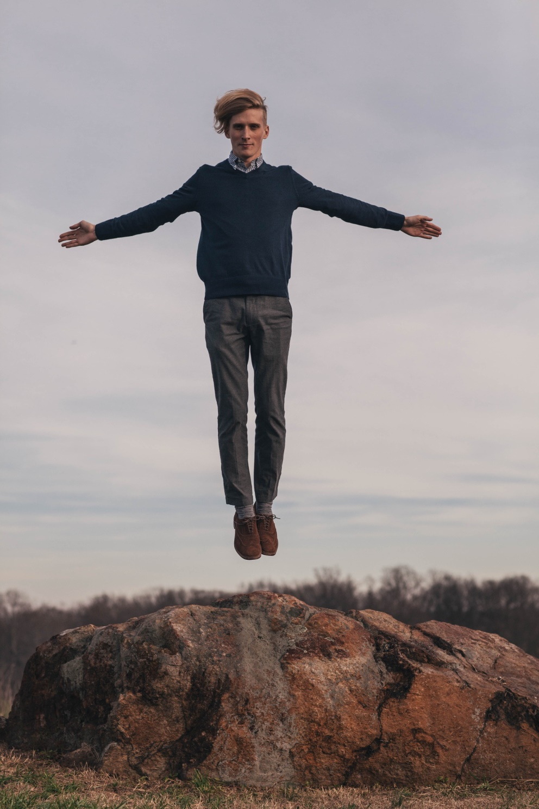
on Empowerment
Allow others to use their God given talents
Prevent burnout
Power of words and actions
Photo by Karina Carvalho on Unsplash
Notes:
Core Value #2--Becky

Slide 5
When asked to define what empowerment looks like I always use this phrase:
Empowerment works best when you put people in a box, then expand the box!
Kurt Johnston
Saddleback Church
Notes:
Joe

Slide 6
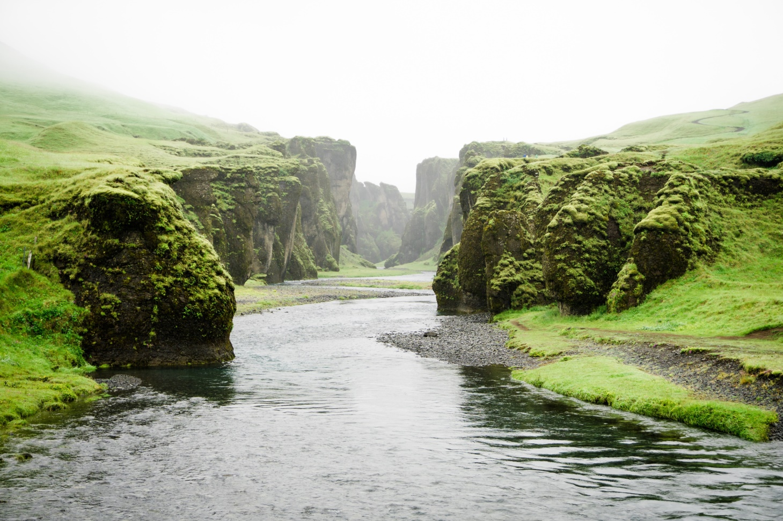
on the Riverbanks
Wisdom of Kairos
Flexibility
Read the Manual
Photo by Martin Sanchez on Unsplash
Notes:
Joe—Does anyone know how to tie a tie?

Slide 8

with Involvement
Know the WHY
Recruit the right people
Train them up right
Build and encourage
Photo by Stephan Vance on Unsplash
Notes:
Becky

Slide 10

with Relationships
Kairos structures
Those with whom we are in ministry
Stakeholders
Photo by Hans-Peter Gauster on Unsplash
Notes:
Joe—handout on Leadership Styles—disempowering words/actions

Slide 12
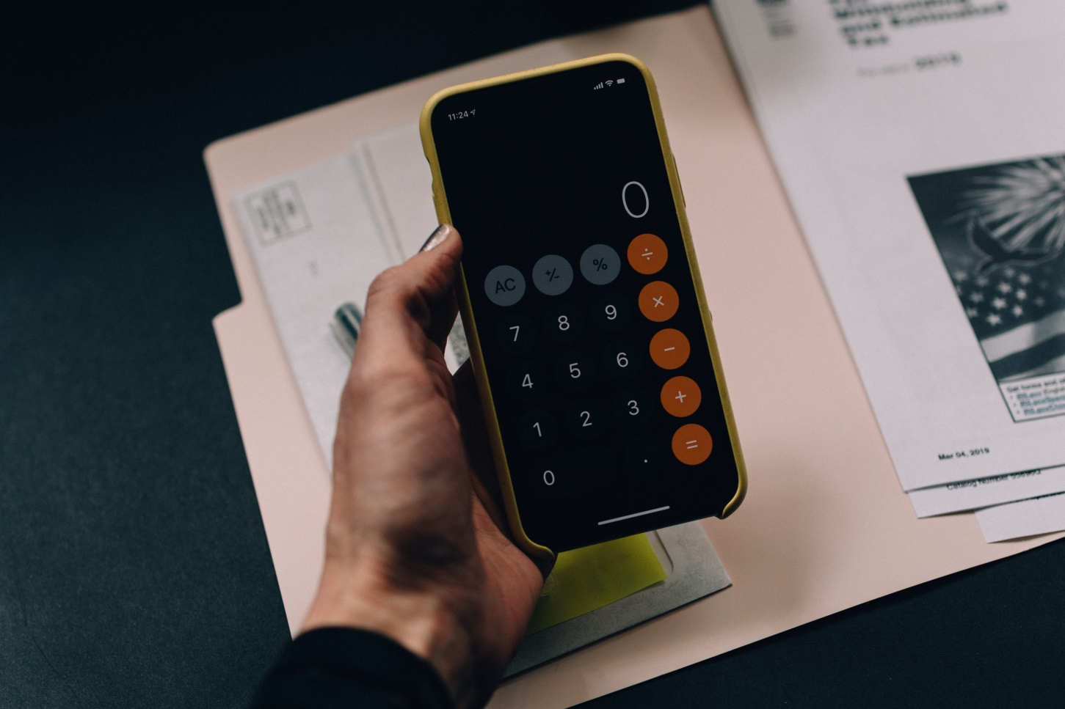
with Accountability
Take responsibility
Set expectations
Evaluate
Photo by Kelly Sikkema on Unsplash
Notes:
Becky

Slide 13
Notes:
Joe’s vignette on accoutability

Slide 14
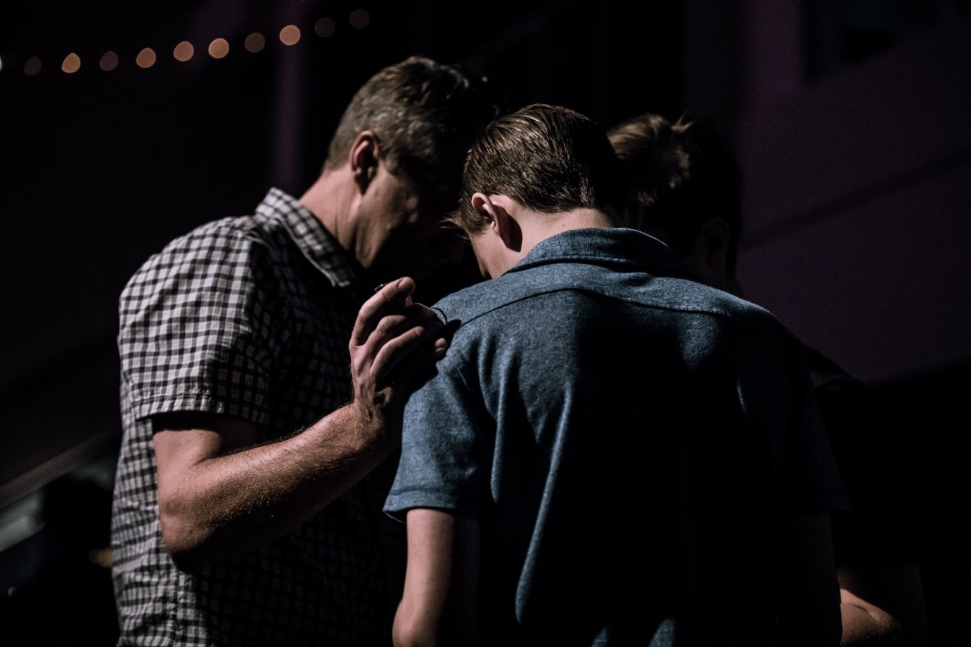
with Christian Community
Torch (9 month average)
Inside (until released)
Outside (until the Rapture)
Photo by Jack Sharp on Unsplash
Notes:
Joe

Slide 15
Notes:
Becky: Katie was a guest at Kairos Outside. She faithfully attended reunions and served on several teams over the years, often speaking of her son. When DNA testing confirmed her son’s innocence after 20 years of incarceration, her entire family joined her at the next reunion. Martin has attended reunions since then. Kairos Outside has become his community, too! We build relationships that cross the Kairos programs. We are better together.

Slide 16
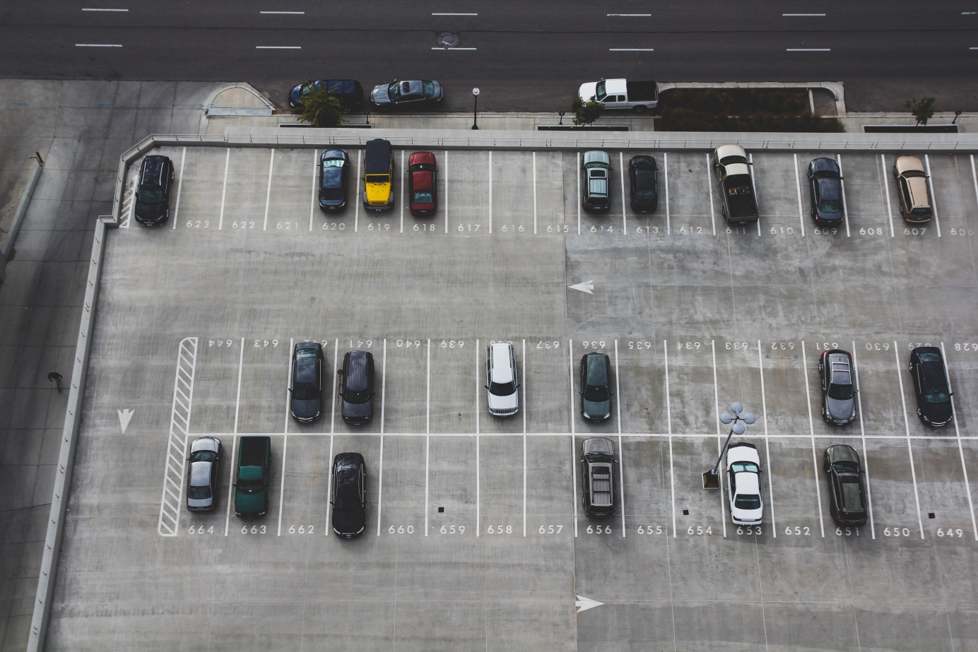
with Q & A
Photo by John Matychuk on Unsplash
Notes:
From the parking lot

Slide 17
Thank you for all you do for Kairos Prison Ministry International!
Notes:
Becky closes with prayer

